Slide 1
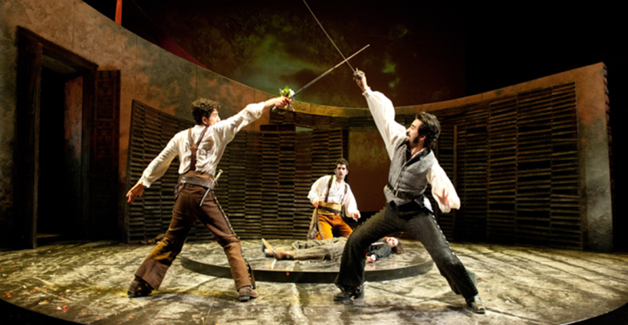
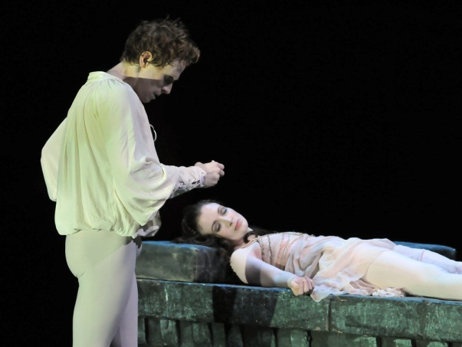
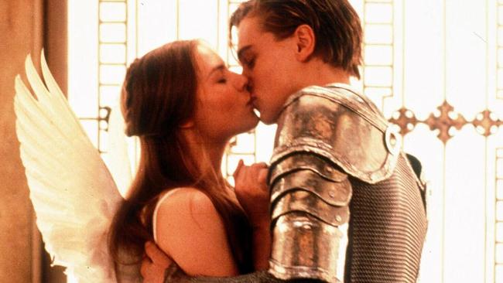
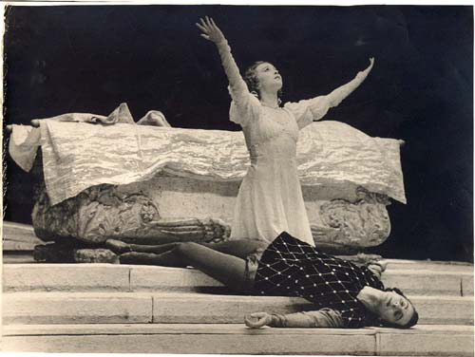
Romeo and Juliet By William Shakespeare
A GFS Production
Notes:
http://www.youtube.com/watch?v=XmO9bqfwxRk&safe=active

Slide 2
Scene 1
Sampson, one of the Capulets, bites his thumb at the
Montagues (a highly insulting gesture) and this starts a
street brawl between the two gangs.
Benvolio, a Montague, tries to stop the fight. However, Tybalt, a Capulet, sees that Benvolio’s
sword is drawn and draws his own. Benvolio explains that he is merely trying to keep the
peace, but Tybalt says that his hatred of peace is as deep as his hatred for the Montagues and
attacks. The brawl spreads.
Prince Escalius arrives , breaks up the fight, and proclaims a death sentence upon anyone who
disturbs the peace again.
After the brawl ends and the crowd disperses, Benvolio sees Romeo approaching and notes
that he is melancholy. Romeo tells Benvolio that he is in love with a woman (Rosaline) but that
she does not return his feelings.
Benvolio advises Romeo to forget her by gazing on other beauties, but Romeo is adamant that
he will never be able to forget his love for Rosaline.

Slide 3
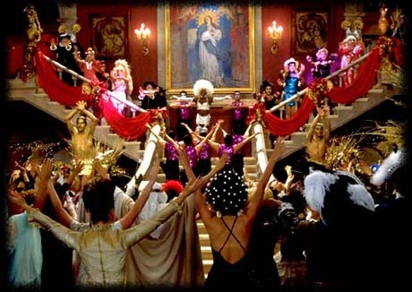
Scene 2
Paris asks Capulet for Juliet's hand in marriage.
Capulet thinks she's too young to be married just yet, but
he invites Paris to a huge Capulet party that night
where Paris plans to woo Juliet.
Benvolio and Romeo hear about the party and decide to go along even though they know that
Montagues aren’t welcome.
Scene 3
Juliet’s mother informs her that Paris will be attending the party and intends to marry her.
Scene 4
On the way to the party Romeo tells Benvolio about a dream he’s had which has made him uneasy.
He feels that something bad is about to happen but he’s not sure what it is.

Slide 4
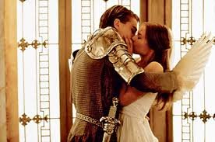
Scene 5
Romeo attends the party. Tybalt spots him and wants to fight him but Capulet persuades him not
to cause a scene and to put away his sword. Tybalt vows that he will get Romeo.
Romeo sees Juliet and is immediately captivated by her.
They talk and kiss but are later heart-broken when they
each find out separately that the other is from the
family they hate.
Scene 6
Mercutio and Benvolio look for their friend Romeo after the party but can’t
find him because Romeo has gone to look for Juliet.
Scene 7
Romeo sneaks into Juliet’s garden. She comes out onto her balcony and they talk about how much
they love each other and want to marry. This is the key romantic scene in the play.

Slide 5
Scenes 8 - 11
Romeo meets Friar Lawrence to ask him to
perform his marriage to Juliet. The friar
agrees to marry them because he hopes that
their union will secure peace between the
feuding families.
Romeo arranges the wedding by plotting
with Juliet’s nurse and the couple
are married in secret.
Scene 12
Tybalt goes looking for Romeo to start a fight.
He meets Mercutio, Romeo’s friend, and they do battle.
Romeo arrives and tries to intervene but when he puts
himself between them Tybalt takes the chance to stab
Mercutio under Romeo’s arm.
Mercutio dies. Romeo is devastated and attacks Tybalt, killing him. Romeo is banished to live in exile.

Slide 6
Scene 13 - 14
Juliet discovers that Romeo has killed her cousin Tybalt and is about to be exiled.
She is devastated and sends her nurse to Friar Lawrence
to pass on a ring to Romeo: a symbol that she still loves
him and remains his faithful wife.
Scene 15
Capulet, not knowing that Juliet is already married to Romeo, agrees that Paris can marry Juliet.
Scene 16
Romeo and Juliet secretly spend one last evening together before Romeo’s banishment. They talk
about how much they love each other and promise that they will be together again.
After Romeo leaves, Juliet’s mother informs her that she has been promised to Paris.

Slide 7
Scene 17 - 18
Juliet goes to seek Friar Lawrence’s help. Together they form a plan: Juliet will take a sleeping
potion to fake her own death. Friar Lawrence will send word to Romeo to inform him of the plan
and after Juliet’s ‘death’ they will sneak away together. Juliet takes the potion and looks forward to
seeing her true love Romeo again.
Scene 19
Friar Lawrence realises with horror that Romeo has not
received his message.
Scene 20
Romeo hears that Juliet has died and believes it to be true. He is so torn apart by despair that he
seeks out an apothecary (historical pharmacist) to buy some poison to kill himself.

Slide 8
Scene 21
Romeo goes to the Capulet tomb where Juliet has been laid to
rest. He sees her sleeping body and believes that she is dead.
After a speech about his love for her and his despair at her
death, he drinks the poison and kills himself.
Juliet wakes up and sees Romeo’s dead body beside her. Realising
what has happened, she is overcome with grief. She tries to kiss
his lips to drink some of the poison from his lips but when this
doesn’t work she takes a dagger and kills herself.
Friar Lawrence comes to wake up Juliet and finds the two bodies side by side. He calls the prince
and the two families together. They are horrified at what has happened and agree to make peace.
Alas, it is too late for Romeo and Juliet.

